Slide 1
Selenium WebDriver
Thanh, Tran Minh
Title/department
Dec 2016
Notes:
GLOBAL NOTE When using different layouts for our HCC template:
Please use the bounding area given inside the title and text boxes and DO NOT stretch to make text fit outside area.
This is so we have consistent space around text and keep the margins given for consistent brand throughout.
When applying a new “Layout” make sure you hit the “reset” button to lock the alignment on titles, subtitles and text.
Try to keep text size consistent throughout. If you have a long title, you may have to make part of it as a subtitle to fit.

Slide 2
Outline
What is Selenium WebDriver
Selenium WebDriver architecture
Set up Eclipse Java Selenium WebDriver Test Project
Basic creation for Web driver instance
Selenium WebDriver basic commands
Data-driven test with Selenium
Assessment

Slide 3
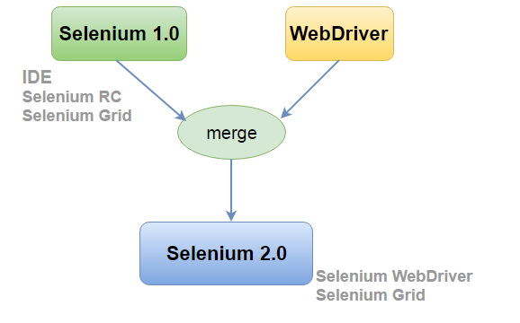
What is Selenium WebDriver?
WebDriver is designed to provide a simpler, more concise programming interface for automating web browser.

Slide 4
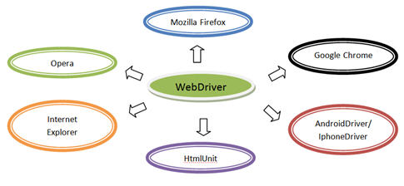
What is Selenium WebDriver?
Supports multiple browsers (Browser Compatibility)
Multiple OSes/ iPhone and Android

Slide 5
What is Selenium WebDriver?
WebDriver provides:
A set of user friendly APIs to automate web browser
Open source, easily integrate with testing framework like JUnit or TestNG
Support the headless browser (invisible browser - it is GUI-less)
Support various programming languages:
Java | CSharp | Javascript | Python | Ruby
Perl (Unofficial) | PHP (Unofficial)

Slide 6
What is Selenium WebDriver?
Advantages and Disadvantages:
Advantages | Disadvantages
Faster than other Selenium tools like Selenium RC (communicate directly to browsers, object oriented API) | No GUI
Support multiple browsers, OSes, programming languages | No built-in report APIs
Write once, run on multiple platforms | Does not ready to support new browsers (depended on the community)
Support headless browser

Slide 7
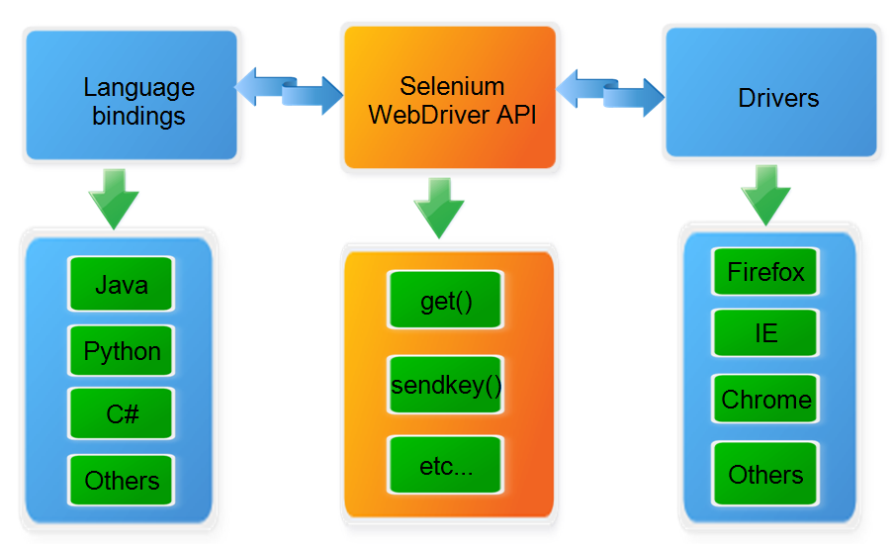
Selenium WebDriver architecture

Slide 8
Set up Eclipse Java Selenium WebDriver Test Project
Prerequisites:
JDK installed (JDK8 is recommended).
Eclipse with TestNG/JUnit plugin installed.
Prepare browser drivers.
Prepare dependent libraries – Selenium Java Client, TestNG, Log4J, POI,….
Set up and configure Apache Maven, then use Maven script.
Manually prepare dependent libraries and configure for test project.

Slide 9
Set up Eclipse Java Selenium WebDriver Test Project
Libraries Links to download:
JDK8 | http://www.oracle.com/technetwork/java/javase/downloads/jdk8-downloads-2133151.html
Eclipse IDE for Java Developers | http://www.eclipse.org/downloads/eclipse-packages/
Apache Maven | https://maven.apache.org/download.cgi
Selenium Java Client and it dependent libraries | http://www.seleniumhq.org/download/
TestNG | TestNG: http://jcenter.bintray.com/org/testng/testng/6.9.12/testng-6.9.12.jar Jcommander: http://jcenter.bintray.com/com/beust/jcommander/1.48/jcommander-1.48.jar
Log4J | http://logging.apache.org/log4j/2.x/download.html
POI | https://poi.apache.org/download.html
Other required libraries

Slide 10
Set up Eclipse Java Selenium WebDriver Test Project
Browser drivers to download:
Chrome driver | https://sites.google.com/a/chromium.org/chromedriver/
Firefox driver (for version 47 or above) | https://github.com/mozilla/geckodriver/releases
Internet Explorer | https://github.com/SeleniumHQ/selenium/wiki/InternetExplorerDriver
Microsoft Edge Driver | https://developer.microsoft.com/en-us/microsoft-edge/tools/webdriver/#downloads
Safari | https://webkit.org/blog/6900/webdriver-support-in-safari-10/
Opera | https://github.com/operasoftware/operachromiumdriver/

Slide 11
Set up Eclipse Java Selenium WebDriver Test Project
Method 1: Use Maven
Download and set up Apache Maven, make sure that system variable JAVA_HOME is defined.
Open Eclipse and create a new A Java Project, it will create some default project configuration files (.classpath, .project)
Create Maven script (pom.xml) with dependent libraries (Selenium java client, TestNG, Log4J, POI,…) inside the new project folder.

Slide 12
Set up Eclipse Java Selenium WebDriver Test Project
Method 1: Use Maven (Cont):
Open command line/terminal, browse to the new project folder location and run some commands below: + mvn clean install → Maven will collect and download the dependent libraries from its repository. + mvn eclipse:eclipse → Maven will re-create Eclipse project configuration files (.classpath, .project) with dependent libraries and overwritten the default configured files.
Create a folder and place the web browser drivers we want to test inside the new project folder.
Re-add source folder for project Java Build Path and it is now ready for develop Selenium WebDriver test cases.

Slide 13
Set up Eclipse Java Selenium WebDriver Test Project
Method 2: Manually set up dependent libraries
Open Eclipse and create a new A Java Project.
Download all necessary dependent libraries (Selenium java client, TestNG, Log4J, POI,…).
Create a folder (named ‘Libs’) and put all dependent libraries inside the project folder.
Add dependent libraries for project Java Build Path.
Create a folder and place the web browser driver inside the project folder, we are ready to develop test cases now.

Slide 14
Basic creation for Web driver instance
Chrome: System.setProperty("webdriver.chrome.driver", “<browser_driver_location>/chromedriver.exe"); WebDriver driver = new ChromeDriver();
Firefox: System.setProperty("webdriver.gecko.driver", "< browser_driver_location>/geckodriver.exe"); WebDriver driver = new FirefoxDriver();
Internet Explorer: System.setProperty("webdriver.ie.driver", "< browser_driver_location>/IEDriverServer.exe"); WebDriver driver = new InternetExplorerDriver();

Slide 15
Selenium WebDriver basic commands
WebDriver instance commands:
Command | Description | Example
get(String url) | Load a new web page in the current browser window. | driver.get(“http://google.com”)
getCurrentUrl() | Get a string representing the current URL that the browser is looking at. | String myURL = driver. getCurrentUrl()
getTitle() | The title of the current page. | String myTitle = driver.getTitle()
getPageSource() | Get the source of the last loaded page. | String myPageSource = driver.getPageSource()
findElement(By by) | Find the first WebElement using the given method. | WebElement footerDiv = driver. findElement(By.id("footer"));
findElements(By by) | Find all elements within the current page using the given mechanism. | List<WebElement> wes = driver.findElements(By.className("width_50"));
close() | Close the current window, quitting the browser if it's the last window currently open. | driver.close();
quit() | Quits this driver, closing every associated window. | driver.quit();

Slide 16
Selenium WebDriver basic commands
WebDriver Navigation commands:
Command | Description | Example
to(String url) | Load a new web page in the current browser window. | driver.navigate().to(“http://google.com”) Same as “driver.get(“http://google.com”)”
to(URL url) | Overloaded version of to(String) that makes it easy to pass in a URL. | URL gURL = new URL(“http://google.com”); driver.navigate().to(gURL)
back() | Move back a single "item" in the browser's history. | driver.navigate().back()
forward() | Move a single "item" forward in the browser's history. | driver.navigate().forward()
refresh() | Refresh the current page | driver.navigate().refresh()

Slide 17
Selenium WebDriver basic commands
WebElement instance commands:
Command | Description | Example
click() | Click this element. | driver.findElement(By.id(“btnSearch”).click()
sendKeys(CharSequence... keysToSend) | Use this method to simulate typing into an element, which may set its value. | driver.findElement(By.id(“txtSearch”).sendKeys(“What is Selenium?”)
clear() | If this element is a text entry element, this will clear the value. | driver.findElement(By.id(“txtSearch”).clear()
getTagName() | Get the tag name of this element. | driver.findElement(By.id(“txtSearch”).getTagName()
getText() | Get the visible | driver.findElement(By.id(“lblSearch”).getText()
getSize() | What is the width and height of the rendered element? | driver.findElement(By.id(“txtSearch”).getSize()
getLocation() | Where on the page is the top left-hand corner of the rendered element? | driver.findElement(By.id(“txtSearch”).getLocation()

Slide 18
Selenium WebDriver basic commands
WebElement instance commands (Cont):
Command | Description | Example
isEnabled() | Is the element currently enabled or not? This will generally return true for everything but disabled input elements. | driver.findElement(By.id(“txtName”).isEnabled()
isSelected() | Determine whether or not this element is selected or not. | driver.findElement(By.id(“chkMale”).isSelected()
isDisplayed() | Is this element displayed or not? This method avoids the problem of having to parse an element's "style" attribute. | driver.findElement(By.id(“txtName”).isDisplayed()
submit() | If this current element is a form, or an element within a form, then this will be submitted to the remote server. | driver.findElement(By.id(“frmSearch”).submit()
getAttribute(String name) | Get the value of the given attribute of the element. | driver.findElement(By.id(“txtSearch”). getAttribute(“autocomplete”)
getCssValue(String propertyName) | Get the value of a given CSS property. | driver.findElement(By.id(“txtSearch”). getCssValue(“width”)

Slide 19
Data-driven test with Selenium
Use TestNG Parameterized Test with DataProviders.
Test Data can be stored in files (Excel file, CSV file).
Use external library (POI, JXL, openCSV) to read test data from file to prepare test data instance for test case.
Develop TestNG parameterized test case with the prepared test data instance.

Slide 20
Assessment 1
Develop an automation script to test invalid cases for the calculator web app below:
http://tranminhthanh.info/training/selenium/SimpleCalculator/
Test scenario:
Open this web page.
For number 1 and number 2, besides the numbers, these fields also accept some characters “.”, “-”, “+”, “e”.
Design test data excel file containing some invalid cases as below: - Number 1 is valid number, number 2 is invalid number containing some Not-A-Number characters as above. - Number 2 is valid number, number 1 is invalid number containing some Not-A-Number characters as above. - Both number 1 and number 2 is invalid number containing some Not-A-Number characters as above. Both cases will expect NaN result.
Use this excel file and develop data-driven test cases.

Slide 21
Assessment 2
Develop an automation script to test a website below:
http://tranminhthanh.info/training/selenium/VirtualMart/
Test scenario:
Open this web page
Select Headpiece product and add 3 Cowboy Hat with size XL to Cart
Back to Home page, select Wear product and add 4 Handmade, Polyester Zipper Pullover to Cart.
Open cart and do check out. -> Selenium script should verify what we’ve chosen
Fill some required information then check out as guest
Verify the inputted information and confirm purchase -> Selenium script should verify our input information.
When finishing the purchase, view your order and verify the order information -> Selenium script should verify our order information.

Slide 22
Questions and discussion

Slide 23
Thank you

